Slide 1
We have introduced random variables from a general perspective and have seen that there are two basic types: discrete and continuous. We examine four particular examples of distributions for random variables which occur often in practice and have been given special names. They are the binomial distribution, the Poisson distribution, the Hypergeometric distribution and the Normal distribution. The ﬁrst three are distributions for discrete random variables and the fourth is for a continuous random variable

Slide 2
Binomial Distributions/Model

Slide 3
The binomial distribution allows us to calculate the probability of observing a certain number of successes in a given number trials.

Slide 4
For the binomial model to be applied the following four criteria must be satisﬁed: • the trial is carried out a ﬁxed number of times n • the outcomes of each trial can be classiﬁed into two ‘types’ conventionally named ‘success’ or ‘failure’ • the probability p of success remains constant for each trial • the individual trials are independent of each other.

Slide 5
Let X be a discrete random variable, being the number of successes occurring in n independent trials of an experiment. If X is to be described by the binomial model, the probability of exactly r successes in n trials is given by P(X = r) = nCr p^{r}q^{n−r.}

Slide 6
A worn machine is known to produce 10% defective components. If the random variable X is the number of defective components produced in a run of 4 components, ﬁnd the probabilities that X takes the values 0 to 4.
Hence the required probabilities are (using the general formula with n = 4 and p = 0.1)
P(X = 0) = (0.9)⁴ = 0.6561
P(X = 1) = 4(0.9)³(0.1) = 0.2916
P(X = 2) = 4×3 /1×2 (0.9)²(0.1)² = 0.0486
P(X = 3) = 4×3×2 /1×2×3 (0.9)(0.1)³ = 0.0036
P(X = 4) = (0.1)⁴ = 0.0001

Slide 7
In a box of switches it is known 10% of the switches are faulty. A technician is wiring 30 circuits, each of which needs one switch. What is the probability that (a) all 30 work, (b) at most 2 of the circuits do not work?(p=0.9)
A University Engineering Department has introduced a new software package called SOLVIT. To save money, the University’s Purchasing Department has negotiated a bargain price for a 4-user licence that allows only four students to use SOLVIT at any one time. It is estimated that this should allow 90% of students to use the package when they need it. The Students’ Union has asked for more licences to be bought since engineering students report having to queue excessively to use SOLVIT. As a result the Computer Centre monitors the use of the software. Their ﬁndings show that on average 20 students are logged on at peak times and 4 of these want to use SOLVIT. Was the Purchasing Department’s estimate correct? (p=4/20 =0.2, q=0.8)

Slide 8
A die is thrown repeatedly 36 times in all. Find E(X) and V (X) where X is the number of sixes obtained. N=36,p=1/6
Expectation and variance of the binomial distribution
E(x)=np var(x)=npq

Slide 9
Poisson Distribution

Slide 10
If we have to determine the probabilities of success when large values of n and small values of p are involved it would be very convenient if we could do so without having to construct tables. In fact we can do such calculations by using the Poisson distribution which, under certain constraints, may be considered as an approximation to the binomial distribution

Slide 11
By considering simpliﬁcations applied to the binomial distribution subject to the conditions 1. n is large 2. p is small 3. np = λ (λ a constant) we can derive the formula P(X = r) = e^{−λ}λ^{r} /r! as an approximation to P(X = r) = nCrq^{n−r}p^{r}.

Slide 12
In the manufacture of glassware, bubbles can occur in the glass which reduces the status of the glassware to that of a ‘second’. If, on average, one in every 1000 items produced has a bubble, calculate the probability that exactly six items in a batch of three thousand are seconds. (n=3000,p=0.001,r=6)

Slide 13
A manufacturer produces light-bulbs that are packed into boxes of 100. If quality control studies indicate that 0.5% of the light-bulbs produced are defective, what percentage of the boxes will contain: (a) no defective? (b) 2 or more defectives? N=100,p=0.005, P(X=0),P(X>=2)

Slide 14
The mean number of bacteria per millilitre of a liquid is known to be 6. Find the probability that in 1 ml of the liquid, there will be: (a) 0, (b) 1, (c) 2, (d) 3, (e) less than 4, (f) 6 bacteria. .(lambda=6)
Expectation and variance of the binomial distribution
E(x)=lambda var(x)=lambda

Slide 15
Hypergeometric Distribution

Slide 16
The distribution given by P(X = r) = ^{M}C_{r} × ^{N−M}C_{n−r} /^{N}C_{n} which describes the probability of obtaining a sample of size n containing r defective items from a population of size N known to contain M defective items is known as the hypergeometric distribution.

Slide 17
The calculations involved when using the hypergeometric distribution are usually more complex than their binomial counterparts. If we sample without replacement we may proceed in general as follows: • we may select n items from a population of N items in NCn ways; • we may select r defective items from M defective items in MCr ways; • we may select n−r non-defective items from N −M non-defective items in N−MCn−r ways; • hence we may select n items containing r defectives in MCr × N−MCn−r ways. • hence the probability that we select a sample of size n containing r defective items from a population of N items known to contain M defective items P(X=r)= ^{M}C_{r} × ^{N−M}C_{n−r} /^{N}C_{n}

Slide 18
A batch of 10 rocker cover gaskets contains 4 defective gaskets. If we draw samples of size 3 without replacement, from the batch of 10, ﬁnd the probability that a sample contains 2 defective gaskets. N=10,M=4,n=3,r=2 P(X=2)=0.3

Slide 19
E(X) = µ = np and V(X) = np(1−p)*N −M /N −1 where p =M/ N

Slide 20
Multinomial Distributions

Slide 21
A multinomial distribution is the probability distribution of the outcomes from a multinomial experiment. Multinomial Experiment A multinomial experiment is a statistical experiment that has the following properties: 1. The experiment consists of n repeated trials. 2. Each trial has a discrete number of possible outcomes. 3. On any given trial, the probability that a particular outcome will occur is constant. 4. The trials are independent; that is, the outcome on one trial does not affect the outcome on other trials.

Slide 22
A binomial experiment is a special case of a multinomial experiment. Here is the main difference. With a binomial experiment, each trial can result in two - and only two - possible outcomes. With a multinomial experiment, each trial can have two or more possible outcomes.

Slide 23
Multinomial Formula. Suppose a multinomial experiment consists of n trials, and each trial can result in any of k possible outcomes: E₁ , E₂ , . . . , E _{k}. Suppose, further, that each possible outcome can occur with probabilities p₁ p₂ . . . p_{k} . Then, the probability (P) that E occurs n times, E occurs n times, . . . , and E occurs n times is:
P = [ n! / ( n₁ ! * n₂ ! * ... n_{k} ! ) ] * ( p₁^{n1} * p₂^{n2} * . . . * p_{k} ^{nk} )
where n = n₁ + n₂ + . . . + n_{k} .

Slide 24
Suppose a card is drawn randomly from an ordinary deck of playing cards, and then put back in the deck. This exercise is repeated five times. What is the probability of drawing s 1queen and 1king
On any particular trial, the probability of drawing a spade, heart, diamond, or club is 0.25, 0.25, 0.25, and 0.25, respectively. Thus, p = 0.25, p = 0.25, p = 0.25, and p = 0.25.
We plug these inputs into the multinomial formula, as shown below:
P = [ n! / ( n₁ ! * n₂ ! * ... n_{k} ! ) ] * ( p₁^{n1} * p₂^{n2} * . . . * p_{k} ^{nk} )
where n = n₁ + n₂ + . . . + n_{k} .
P = [ 5! / ( 1! * 1! * 1! * 2! ) ] * [ (0.25) * (0.25) * (0.25) * (0.25) ]
P = 0.05859
Thus, if we draw five cards with replacement from an ordinary deck of playing cards, the probability of drawing 1 spade, 1 heart, 1 diamond, and 2 clubs is 0.05859

Slide 25
Suppose we have a bowl with 10 marbles - 2 red marbles, 3 green marbles, and 5 blue marbles. We randomly select 4 marbles from the bowl, with replacement. What is the probability of selecting 2 green marbles and 2 blue marbles?

Slide 26
Negative Binomial Distribution

Slide 27
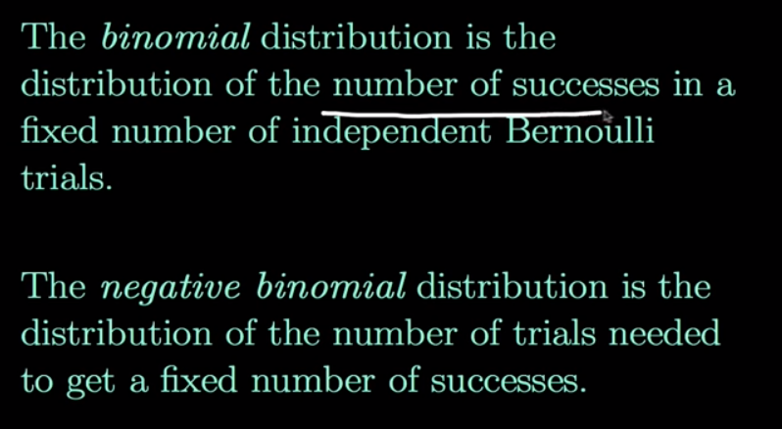

Slide 28
Negative Binomial Formula. Suppose a negative binomial experiment consists of x trials and results in rth successes. If the probability of success on an individual trial is P, then the negative binomial probability is: P(X = r) = ^{n-1}C_{r-1} p^{r}q^{n−r.}

Slide 29
Bob is a high school basketball player. He is a 70% free throw shooter. That means his probability of making a free throw is 0.70. During the season, what is the probability that Bob makes his third free throw on his fifth shot? Solution: This is an example of a negative binomial experiment. The probability of success (P) is 0.70, the number of trials (x) is 5, and the number of successes (r) is 3. To solve this problem, we enter these values into the negative binomial formula. P(X = r) = ^{n-1}C_{r-1} p^{r}q^{n−r.} P(X=3)=⁴C₂ 0.7³ 0.3² ^{0.18522}

Slide 30
The Mean of the Negative Binomial Distribution If we define the mean of the negative binomial distribution as the average number of trials required to produce r successes, then the mean is equal to: μ = r / P where μ is the mean number of trials, r is the number of successes, and P is the probability of a success on any given trial. Var=r(1-p)/p²

Slide 31
Permutations

Slide 32
Permuatation represent the selection of some or all of a number of different objects where the order of selection is important
Combinations represent the selection of some or all of a number of different objects where the order of selection is immaterial

Slide 33
Example 1: Suppose you want to arrange your English, Hindi, Mathematics, History, Geography and Science books on a shelf. In how many ways can you do it?
Example 2: Suppose you have 6 happy birthday cards for your friends and you want to send them to 4 of your friends. In how many ways can you send these cards to 4 of your friends?
Example 3: In a library, there are 4 books on fairy tales, 5 books are novels and 3 books are on plays. In how many ways can you arrange these so that books on the fairy tales are together in one place. The novels are together and plays are also together. The requirement is that these books should be in a specific order i.e., books on fairy tales, before novels, before plays.
Example 4: In the above example what is the number of permutations if the books are not to be kept in order?
Example 5: In how many ways can 4 girls and 5 boys be arranged in a row so that all the four girls are together?
Example 6: There are 6 boys who enter a boat with 8 seats, 4 on each side. In how many ways can they sit anywhere on the boat?

Slide 34
Combinations

Slide 35
1. Find the number of subsets of the set {1, 2, 3, 4, 5, 6, 7, 8, 9, 10, 11} having 4 elements.
2. The Indian Cricket team consists of 16 players. It includes 2 wicketkeepers and 5 bowlers. In how many ways can you select a cricket team of eleven players if you have to select 1 wicketkeeper and at least 4 bowlers?
3. A committee of 5 people is to be chosen from a group of 6 men and 4 women. How many committees are possible if there are no restrictions?
4. A committee of 5 people is to be chosen from a group of 6 men and 4 women. How many committees are possible if there are to be 3 men and 2 women?

Slide 36
Characteristic Function

Slide 37
In probability theory and statistics, the characteristic function of any real-valued random variable completely defines its probability distribution. If a random variable admits a probability density function, then the characteristic function is the Fourier transform of the probability density function. Thus it provides the basis of an alternative route to analytical results compared with working directly with probability density functions or cumulative distribution functions. There are particularly simple results for the characteristic functions of distributions defined by the weighted sums of random variables.

Slide 38
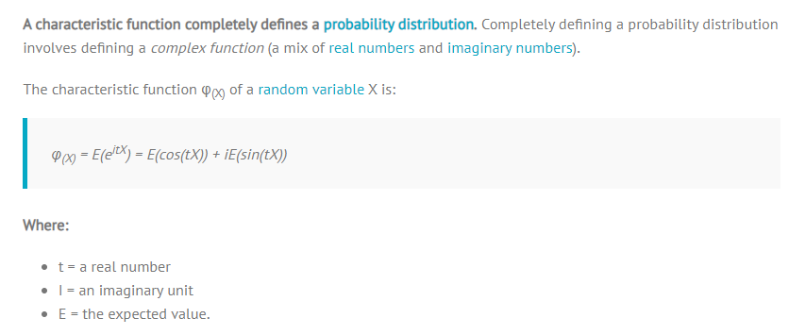

Slide 39
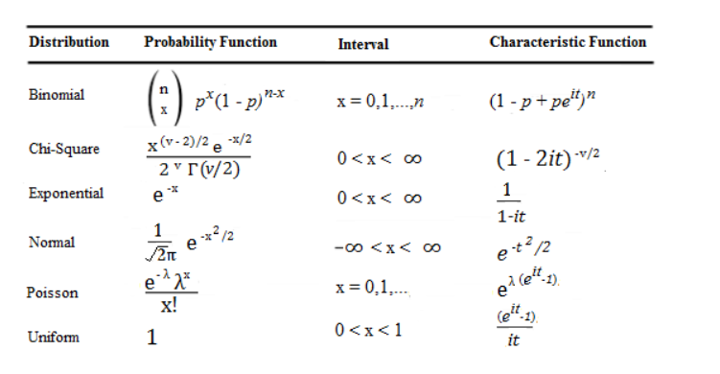

Slide 40
The characteristic function of a real-valued random variable always exists, since it is an integral of a bounded continuous function over a space whose measure is finite.
A characteristic function is uniformly continuous on the entire space
It is non-vanishing in a region around zero: φ(0) = 1.
It is bounded: |φ(t)| ≤ 1.
It is Hermitian: φ(−t) = φ(t). In particular, the characteristic function of a symmetric (around the origin) random variable is real-valued and even.
There is a bijection between probability distributions and characteristic functions. That is, for any two random variables X₁, X₂, both have the same probability distribution if and only if .
If a random variable X has moments up to k-th order, then the characteristic function φ_{X} is k times continuously differentiable on the entire real line

Slide 41
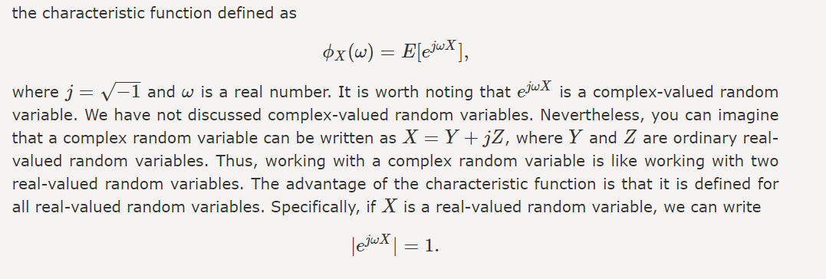

Slide 42
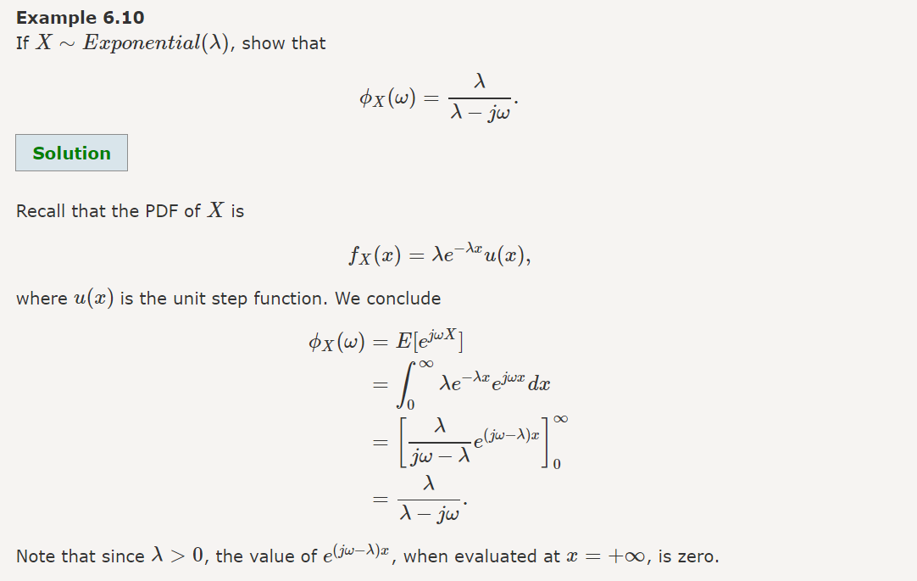

Slide 43
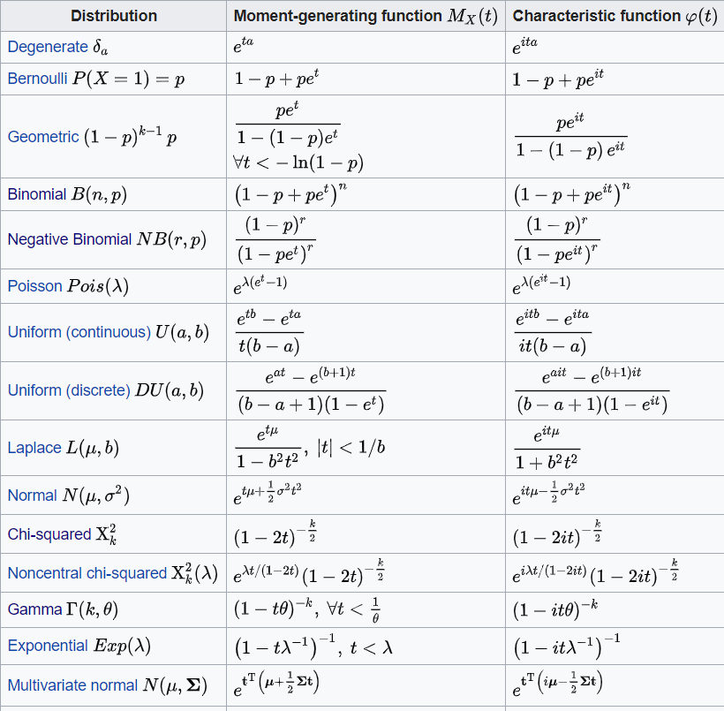

Slide 44
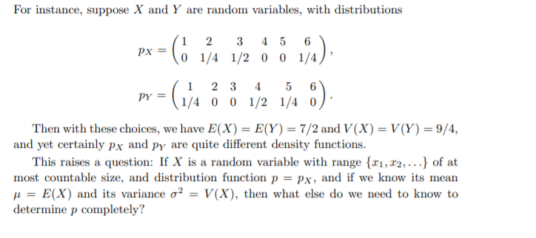

Slide 45
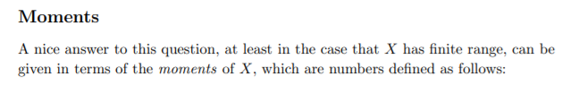
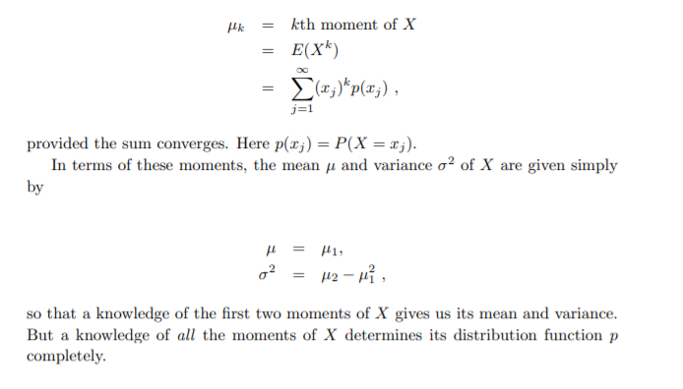

Slide 46
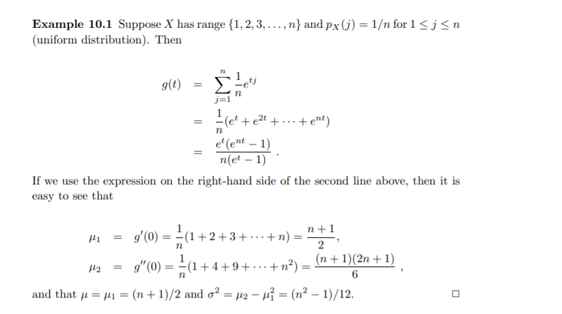

Slide 47
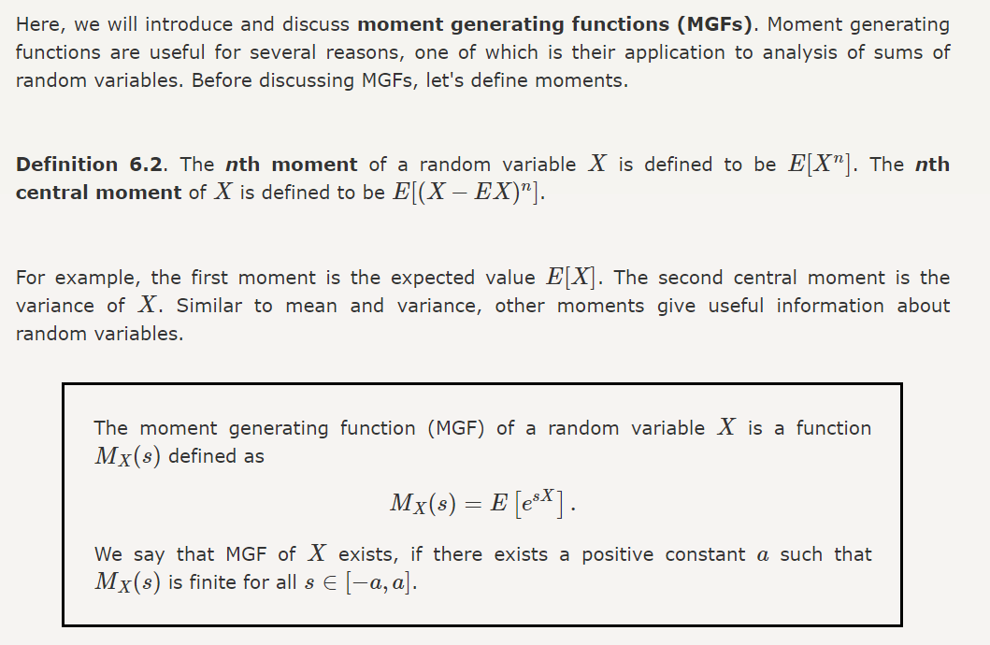

Slide 48
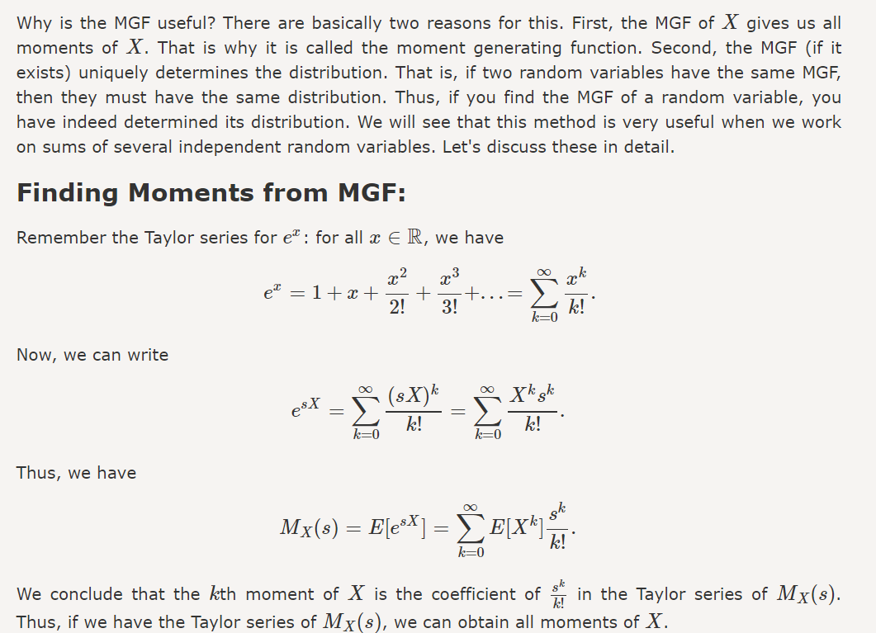

Slide 49
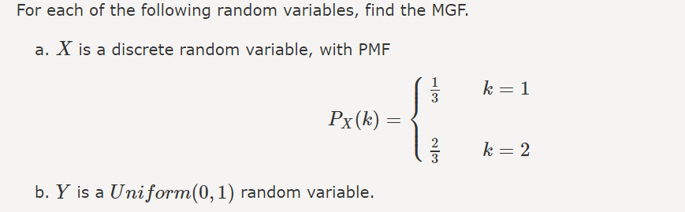
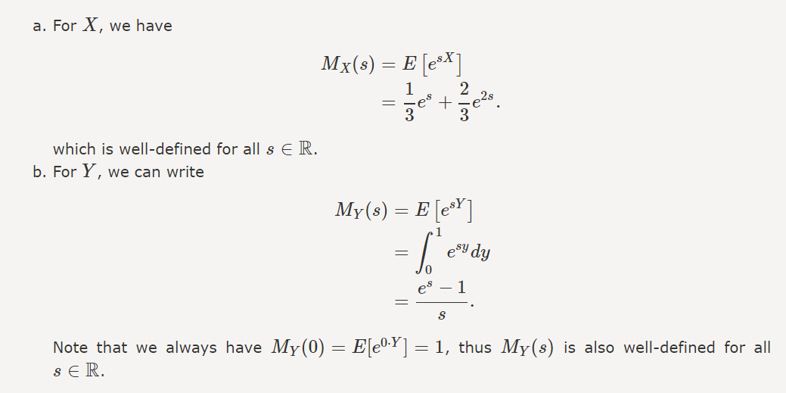

Slide 50
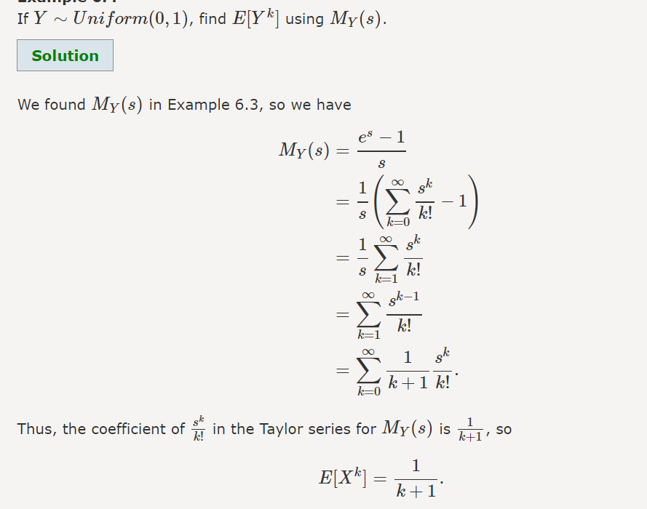

Slide 51
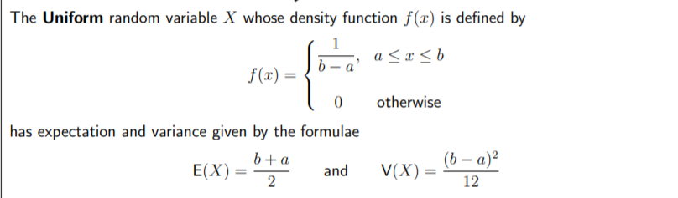

Slide 52
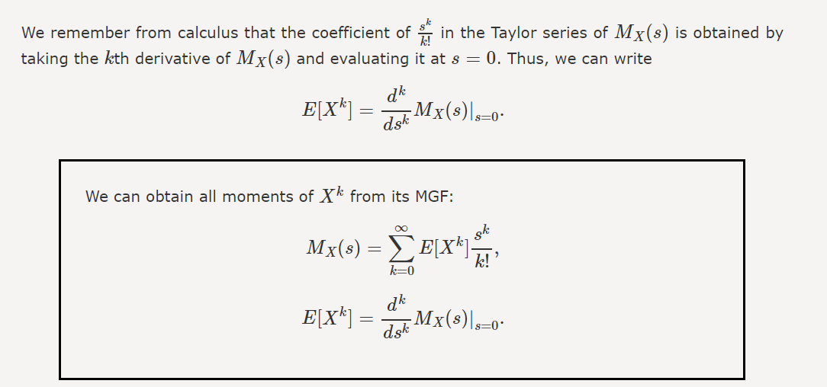

Slide 53
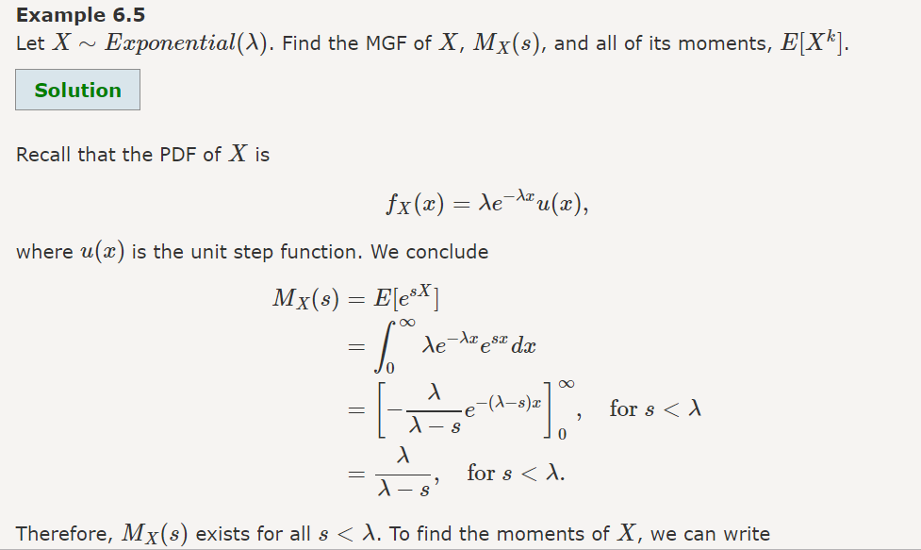

Slide 54
